Slide 1
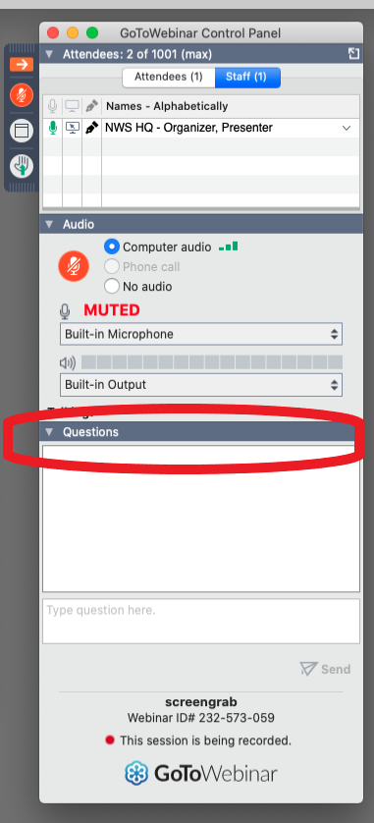
Welcome to today’s Spot Transition Update Webinar, we will be starting shortly.
All participants will be in “listen-only” mode only.
The control panel can be toggled on/off using the orange arrow at the top left (see image to the right).
Please submit questions via the Questions/Chat tab on your GotoWebinar toolbar (see image to the right). We’ll answer as many as we can in the Q&A section of the presentation.
Notes:
Run of Show

Slide 2
Spot Transition Update
June 24 , 2024
Notes:
Speaker: George
Talking Points for George - SPOT is undergoing transition. We appreciate how important this tool is to our partners. We had over 37 K SPOTs submitted in 2023 alone. It has been a complex transition to move this to IDP from legacy infrastructure, but with everyone’s help we will be able to get this done. We look forward to updating you today and along the way of our progress and any feedback that anyone has.
We want to ensure that the application meets the needs of forecasters and partners. We are working together to focus on critical functionality first, but will turn our attention to restoring legacy functionality as soon as possible.

Slide 3
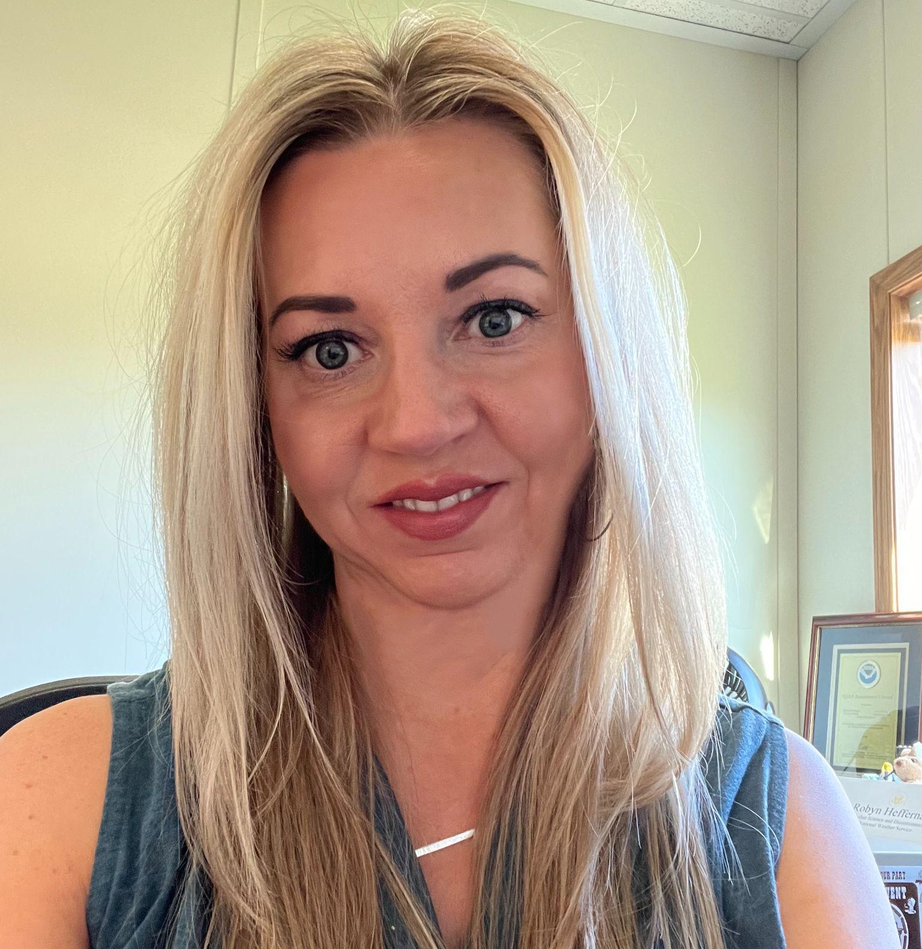
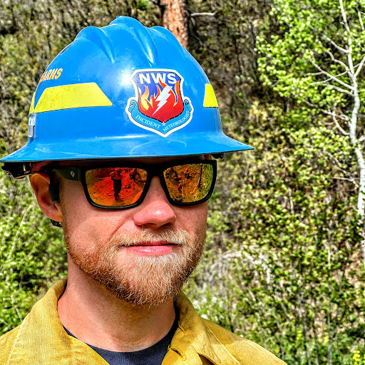
Speakers
Moderator/Presenter
Presenter
Kate Hilscher
Ken’s 10 Communications Lead
Robyn Heffernan
Fire Weather Services Senior Advisor
Panelist
Panelist
Panelist
Tech Panelist
Scott Stearns
Fire Weather Coordinator
Julie Malingowski
Fire Weather Coordinator
Brian Miretzky
Digital and Graphical Information Support Branch
Carissa Klemmer
Implementation and Data Services Branch Chief
Notes:
Speaker: George - introduces speaker and panel

Slide 4
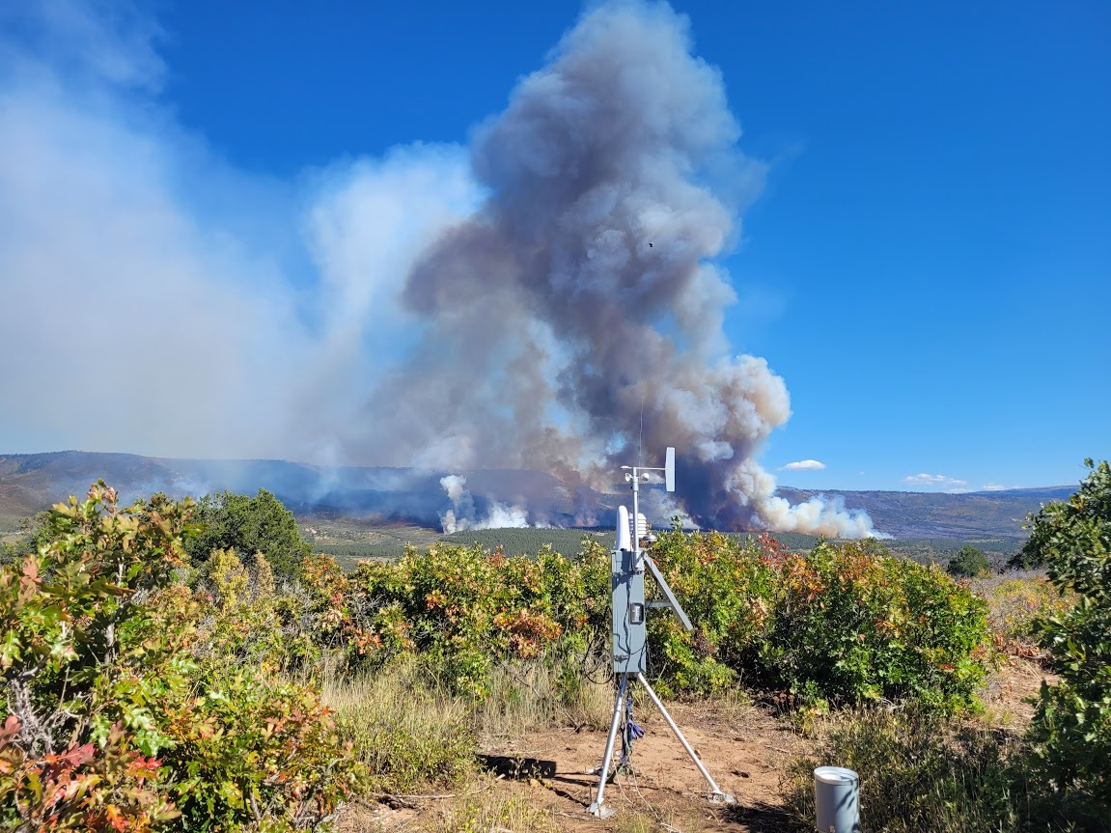
Overview of Spot Page
Site-specific (spot) forecasts are issued by service offices, per request, in support of wildfire management, natural resource management, hazardous materials incidents, marine incidents, search and rescue response and other threats to public safety, including the provision of IDSS to Core Partners.
NWS 10-401, section 4
NWS 10-2403, section 1.1.4
Notes:
Speaker: Robyn (2 minutes)

Slide 5
New Spot Webpage
https://spot.weather.gov/
Why is the Spot application changing?
NWS invested in fire-weather to improve code, stabilize the system, and enhance the user experience of Spot
The new IT infrastructure for Spot provides redundancy for back-up and allows for future enhancements
What do you need to know about the new Spot application?
Similar look and feel, and core functionality will remain the same
Transitioning will require a small learning curve
The Website URL is changing - update bookmarks and documentation
Old URL will forward to the new Spot page for 6 months post transition
We appreciate your patience through the transition!
Notes:
Speaker: Robyn (3 minutes)

Slide 6
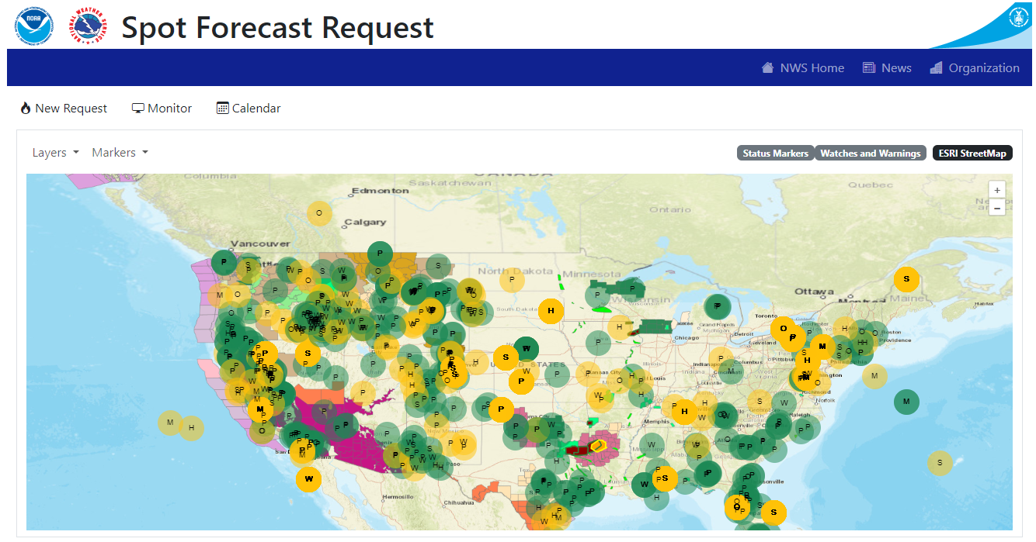
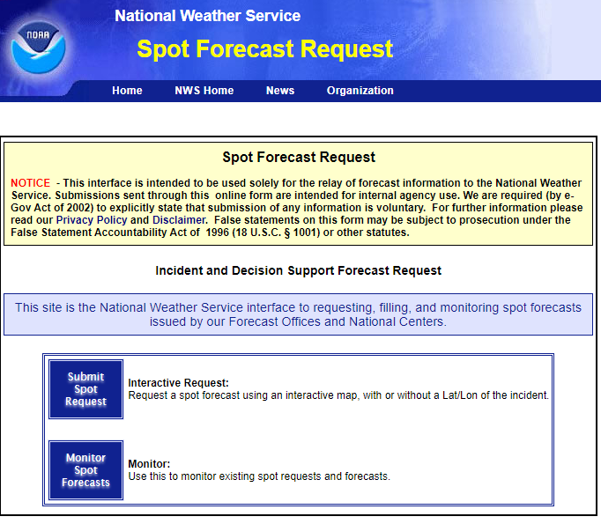
What to Expect Tomorrow, June 25, 2024
Users will be redirected from weather.gov/spot to spot.weather.gov* at 7:30AM MDT / 9:30AM EDT
*The date is tentative and may change due to a Critical Weather Day or other major operational impacts
https://www.nco.ncep.noaa.gov/status/cwd/ https://www.nco.ncep.noaa.gov/status/messages/
Notes:
Brian

Slide 7
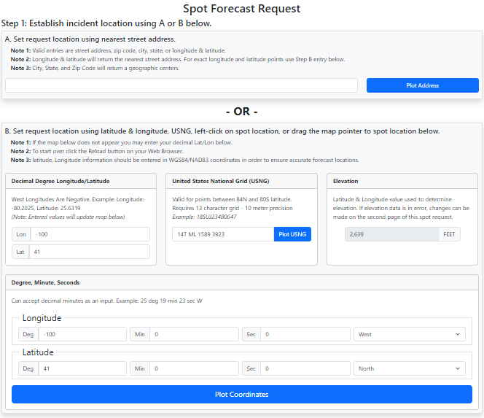
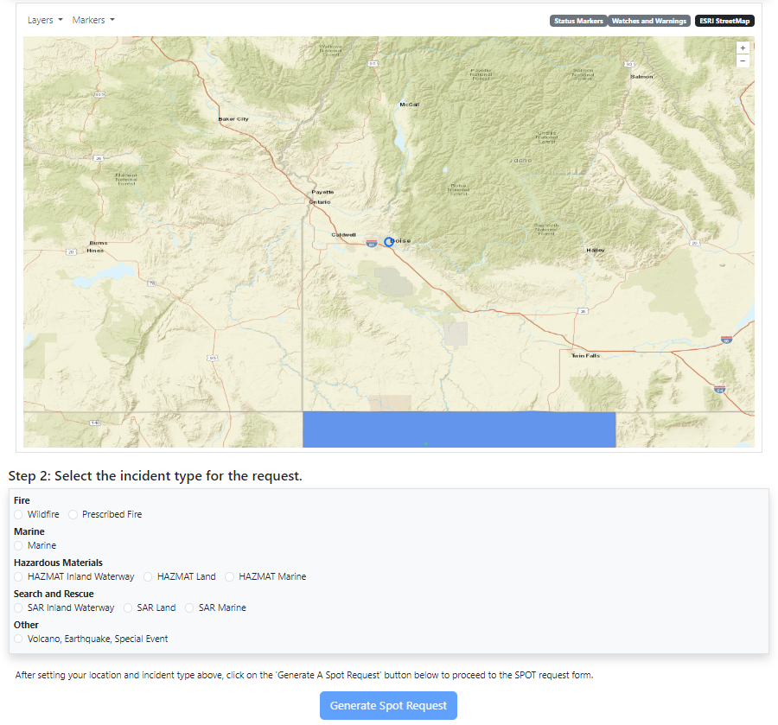
Spot Request Form

Slide 8
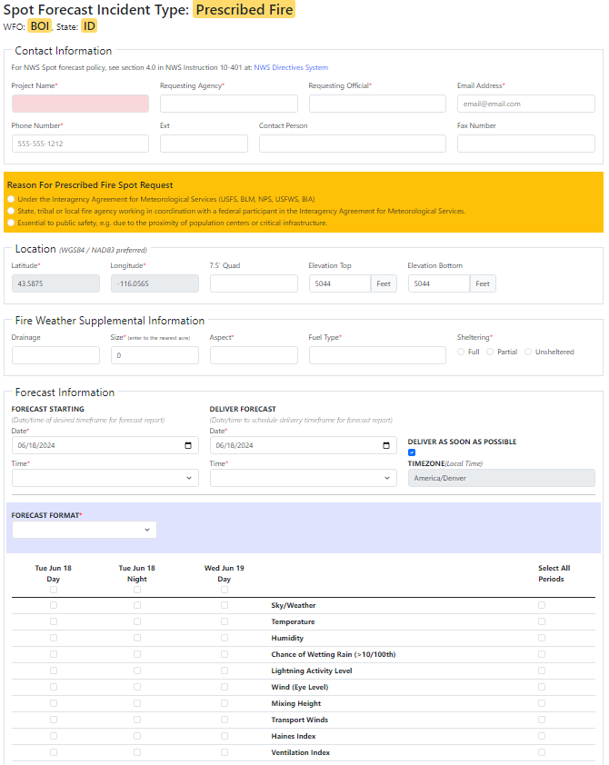
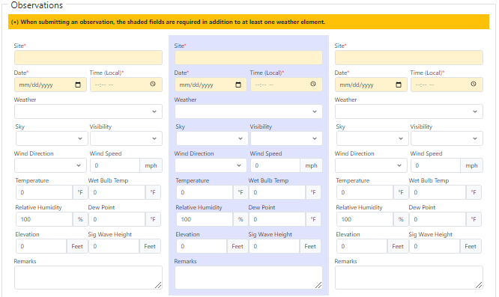
Spot Request - detailed

Slide 9
Calendar

Slide 10
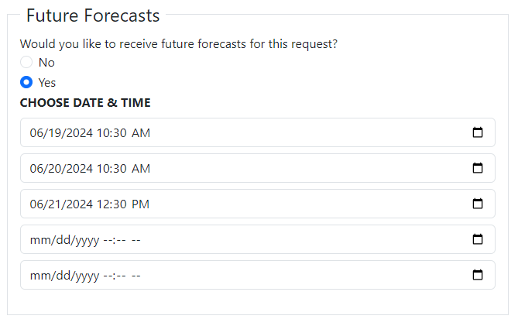
What’s New
An email token is provide for edit access to requests
token is sharable
Future Forecasts feature
some aspects of dates/times still need work

Slide 11
User Experience Challenges
Please contact your local WFO with questions or concerns.
Monitor cannot be filtered to only show requests for a specific office (*can be sorted)
When editing an existing request, some fields are not retained
Clicking on the map multiple times will result in multiple markers
Map markers may not be the correct color on the monitor
Decimal points in weather elements are not allowable
No plot button for decimal degrees
RH observation must be input - no auto calculation
The map is squished on display map

Slide 12
Training Resources and Feedback Form
Feedback: nws.webfeedback@noaa.gov
Training Materials: https://www.weather.gov/fire/training
Information for Partners: https://www.weather.gov/media/fire/FINAL_%20SPOT%20Update%20for%20Partners.pdf
Please contact your local WFO with questions or concerns.
https://www.weather.gov/contact/

